Slide 1
AD8512 - Mini Project on Data Sciences Pipeline
Automated Attendance prediction system (AAPs)
.10.2022
Batch No. : 12
Presented by
AJAY SHARON R S – 311020243004
AKASH G – 311020243005
VISHNU M – 311020243054

Slide 2
Objective
To develop an System which can mark attendance of any number of students at a time with Image.

Slide 3
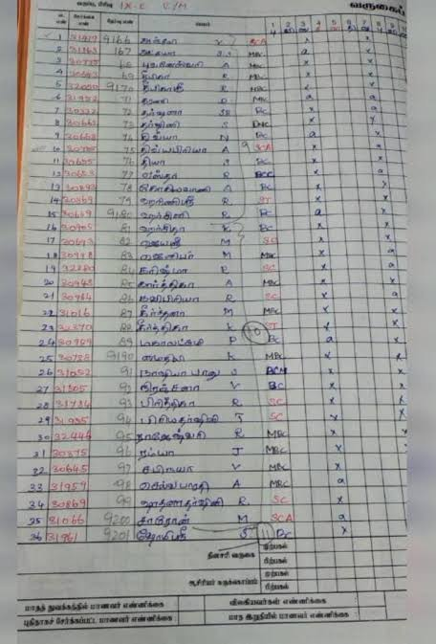

Motivation

Slide 4
Introduction to the Domain
Introduction to the domain
Principle component Analysis(PCA) is used to predict the person in the image. After segmentation of the face image in the class room.

Slide 5
Project Description
This project provides features such as detection of faces, extraction of the features, detection of extracted features, and analysis of students' attendance.
The system integrates techniques such as image contrasts, integral images, color features and cascading classifier for feature detection.
Marking the attendance in the excel sheet corresponding to their names.

Slide 6
Base Paper
<Name of the author(s)> <Year of Publication>, “<Title of the Paper>”, <Publication Details>
Example:
D. Schwarz, H. Kloeden, and R. Rasshofer (2016), “Ko-TAG—Cooperative senso
technology for traffic safety applications,” in Proc. Int. Workshop Intelligent Transportation, vol 2. no. 5, pp 245-250.
Contribution | Detection of Vehicle Over Speeding and warning the driver.
Methodology | Controller designed using Arduino Mega to monitor the location and speed of the vehicle obtained using a GPRS+GPS Quadband Module (SIM908), GSM antenna, GPS antenna and SIM card
Outcome | Providing Warning on over speeding. imposing penalty for the speeding offenders
Challenges | Only over speeding is detected.
Future Scope | In future the over speed detection devices could be incorporated into every vehicle which will reduce the incidents of accidents on roads and various premises, with subsequent reduction in loss of life.

Slide 7
Supporting Paper 1
<Name of the author(s)> <Year of Publication>, “<Title of the Paper>”, <Publication Details>
Example:
D. Schwarz, H. Kloeden, and R. Rasshofer (2016), “Ko-TAG—Cooperative senso
technology for traffic safety applications,” in Proc. Int. Workshop Intelligent Transportation, vol 2. no. 5, pp 245-250.
Contribution | Detection of Vehicle Over Speeding and warning the driver.
Methodology | Controller designed using Arduino Mega to monitor the location and speed of the vehicle obtained using a GPRS+GPS Quadband Module (SIM908), GSM antenna, GPS antenna and SIM card
Outcome | Providing Warning on over speeding. imposing penalty for the speeding offenders
Challenges | Only over speeding is detected.
Future Scope | In future the over speed detection devices could be incorporated into every vehicle which will reduce the incidents of accidents on roads and various premises, with subsequent reduction in loss of life.

Slide 8
Supporting Paper 2
<Name of the author(s)> <Year of Publication>, “<Title of the Paper>”, <Publication Details>
Example:
D. Schwarz, H. Kloeden, and R. Rasshofer (2016), “Ko-TAG—Cooperative senso
technology for traffic safety applications,” in Proc. Int. Workshop Intelligent Transportation, vol 2. no. 5, pp 245-250.
Contribution | Detection of Vehicle Over Speeding and warning the driver.
Methodology | Controller designed using Arduino Mega to monitor the location and speed of the vehicle obtained using a GPRS+GPS Quadband Module (SIM908), GSM antenna, GPS antenna and SIM card
Outcome | Providing Warning on over speeding. imposing penalty for the speeding offenders
Challenges | Only over speeding is detected.
Future Scope | In future the over speed detection devices could be incorporated into every vehicle which will reduce the incidents of accidents on roads and various premises, with subsequent reduction in loss of life.

Slide 9
Inference of Literature Review
Present the Core extract of the literature review.
Base Paper | To design a device such that it will reduce the incidents of accidents on roads and various premises, with subsequent reduction in loss of life and property
Supporting Paper 1 | To assess the driving safety indicator through making scores on driver background and driving habits synthetically. System architecture is explained in detail for the analysis process and three algorithms.
Supporting Paper 2 | To assess the driving behavior through dashboard data and analyze the behavior and send human readable vehicular information to the mobile phone.
<Any other reference>

Slide 10
Extraction from the Literature Survey for the proposed system
Present the Methodology / algorithm extracted from the literature survey to be used in the proposed system.
Base Paper | The development of a data acquisition system embedded within a vehicles equipped with OBD II interface. The system is coupled to a GPS allowing tracking both engine data and vehicle speed and position along a driving path.
Supporting Paper 1 | Logistic Regression– to assess driving data, and output scores to indicate different levels of good/bad driving patterns. Data Parameters such as hard acceleration , hard braking, total distance is used.
Supporting Paper 2 | Data parameters are standardized and can be converted to human-readable form using a J1939 DBC file ,and can be transmitted to the mobile phone using J1939 Bridge via Bluetooth.
<Any other reference>

Slide 11
Problem Definition
Description of problem identified.
Example
In any accident prevention system, the parameters like speed, heavy acceleration, sudden deceleration, hard braking, sharp turning, changing lane without using light, etc were considered, but the speed limit violation is not used which has large impact on rash driving.
Driving Behavior Analysis has been done using Logistic Regression on non-linear data which will make the efficiency of model very low.

Slide 12
Proposed Solution
Proposed solution / innovation with the technology to be used.
Example
To create a system that will get the location of vehicle and send it to main processing system , where the location will be used to retrieve the corresponding speed limit of road where vehicle is there using google services and maps API.
The system gives warning to driver through Mobile App if driver crosses the speed limit and the speed limit violations will be send to the server where it will be used as one of the factor to rate the driver’s driving behavior.
Decision Tree Algorithm can be used for rating of the driver

Slide 13
Proposed Solution - Justification
<Justify the need of the technology/algorithm to be used in the proposed system>

Slide 14
Requirement Specification
Software
<Put ‘NA’ for non requirements>
FRONT END TOOLS
BACK END TOOLS
MARKUP LANGUAGES
SCRIPTING LANGUAGES
MIDDLE WARE TECHNOLOGIES
IDE
SIMULATION TOOLS
NETWORK/WIRELESS TECHNOLOGIES
ANY OTHER
Hardware
<List the hardware requirements with specification-
This is applicable only for hardware oriented projects.
No need of giving information about monitor/keyboard/mouse etc. >

Slide 15
Requirement Specification - Justification
<Justify the need of the Software/Hardware components>
Comparison table may be presented

Slide 16
Architecture Diagram
Overall architecture diagram of the project
Appropriate UML diagrams shall also be used to give pictorial representation about the overall components of the project

Slide 17
Module Description
List and describe individual modules in different slides.
Describe the functionality (User perspective) of each module.
Describe the development strategy individual modules as developer perspective
For each and every module, the input, the functional process (algorithm/strategy) and the output to be fed as input next module (interaction) should be explained diagrammatically using functional block diagram.

Slide 18
Project Flow diagram

Slide 19
Algorithm Explanation
Explain the algorithm used – steps/psudocode/flowchart, in different slides

Slide 20
Implementation
Explain the program logic (part of coding) used, in different slides

Slide 21
Screenshots
Present the screen shots of work progress/deliverables of modules

Slide 22
Conclusion and Future Scope
Conclude the work done
Present the avenues for further development

Slide 23
References
Give details of the journals/books referred. The reference material should be listed in the alphabetical order of the first author. The year of publication must be followed after the authors’ name. Volume No. and PP must be specified.
1. <Name of the author(s)> <Year of Publication>, “<Title of the Paper>”, <Publication Details>
Example:
Ivan Lequerica, Pedro M. Ruiz and Victor Cabrera (2010), “Improvement of Vehicular Communications by Using 3G Capabilities to Disseminate Control Information”, IEEE Network., vol. 24, no. 1, pp 32-38.
Schwarz D, Kloeden H, and Rasshofer R (2016), “Ko-TAG—Cooperative sensor technology for traffic safety applications,” in Proc. Int. Workshop Intelligent Transportation, pp 245-250.
Authors
Year
Title
Volume & Number
Page to Page
Name of the Journal

Slide 24
THANK YOU

